Slide 1
ICT Symposium
Trusted Tester Testing Workshop

Slide 2
Presenters
Andrew Nielson
anielson@neweditions.net
Kristen Smith
ksmith@neweditions.net
Ann Marie Davis
annmarie.davis@associates.hq.dhs.gov

Slide 3
Workshop Goals
Provide an understanding of the Trusted Tester certification course
Introduce you to use of the ANDI tool
Give you hands-on experience testing using ANDI
Provide testing tips and tricks
Expose you to some of the FAQ

Slide 4
Today’s Topics
Quick overview (Ann Marie)
Topic 4 Keyboard and Focus (Ann Marie)
Topic 10 Content Structure (Ann Marie)
Topic 5 Forms (Kristen)
Topic 6 Links and Buttons (Andrew)
Topic 7 Images (Andrew)
Questions
Wrap up and certification process

Slide 5
Origins of the Course
Section 508 Requirements and need to test – USCIS developed test checklist and DHS significantly revised to created detailed test steps and repeatable test process to train IT testers in the federal space
W3C developed guidance for Accessibility for use through out the IT Community - WCAG
U.S. Access Board, charged with the federal governments approach to meeting Section 508 Requirements, adopted WCAG 2.0 level A and AA for use in the Federal Government
DHS works with Access Board to revise the test process to align with WCAG 2.0
DHS develops a new course to certify testers for accessibility in the federal space and opens the course free of charge to the general public.
SSA provides resources to develop a tool for testers to use –ANDI is born

Slide 6
Genesis of the Trusted Tester Course
World Wide Web Consortium (W3C)
W3C develops Web Content Accessibility Guidelines (WCAG )
U.S. Access Board adopts (WCAG 2.0 A and AA standards)
DHS OAST develops training to certify testers in the accessibility test process
Federal Section 508 SMEs develop test process and ANDI tool
Accessibility Test Process approval by Federal CIO Council – ACoP*
* Accessibility Community of Practice

Slide 7
Trusted Tester Process
Previous version 4.0 | New version 5.0
Repeatable process | Repeatable process
Uses multiple free tools (favelets) | Uses ANDI tool developed especially for accessibility testing
Uses Color Contrast Analyzer (CCA) to determine 4.5:1 ratio | Limited use of CCA with background images – ANDI calculates both text size and contrast to apply lower large font requirements
Requires knowledge of HTML and ARIA | Requires very little knowledge of HTML and ARIA
Questions phrased in negative (the failure condition use of double-negative) | Questions phrased in positive (what is required to pass)
Use of C (Compliant) and NC (Non-compliant) | Use of TRUE and FALSE to determine if a test condition PASSES and FAILS

Slide 8
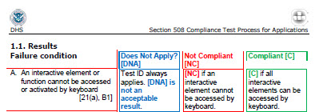
Historical view of test process
4.0
5.0
Check 2.1.1-keyboard-access
Test Name | Test ID | Test Condition
2.1.1-keyboard-access | 4.A | All functionality can be accessed and executed using only the keyboard.
Evaluate Results:
If BOTH of the following are TRUE, the content PASSES:
All functionality can be accessed and executed using the keyboard, AND
All essential information can be accessed via keyboard interaction OR the information is available elsewhere on the page.

Slide 9
Benefits of new process
Use of ANDI takes guess work out of whether ARIA or HTML code is sufficient
Test conditions are phrased for binary responses (true/false) to allow use of automated testing tools where possible

Slide 10

Overview of ANDI
Accessible Name and Description Inspector accessibility testing tool developed by SSA (Lead developer John Cotter)
focusable elements
graphics/images
links/buttons
structures
color contrast
hidden content
tables
iframes
Linearize page feature

Slide 11
Keyboard access and focus
Topic 4

Slide 12
Keyboard Testing
Remains a manual test process requiring interactive elements to be keyboard accessible
Requires exploration with a mouse to identify interactive elements (incl. drop-down menus, tool tips, form fields, hidden content, interactive elements)
Use of [TAB] and [SHIFT + TAB], arrow keys, [Esc] key and [ENTER] to navigate using the keyboard
Tips:
Include any changes to functionality that occur automatically or due to interaction with the page.
Information is considered essential or required when it is necessary to execute an action or understand information and relationships.
Notes:
Grand Canyon site is an example of 4.F – move example

Slide 13
4.A 2.1.1-keyboard-access
Test Name | Test ID | Test Condition
2.1.1-keyboard-access | 4.A | All functionality can be accessed and executed using the keyboard.
Evaluate Results:
If BOTH the following are TRUE, the content PASSES:
All functionality can be accessed and executed using the keyboard.
All essential information can be accessed using the keyboard OR the information is available elsewhere on the page.
Tips
Focus on non-interactive elements is permitted.
Test any automatic changes resulting from interaction with the page.
Non-essential title/tooltip information is NOT required to have keyboard access.
Notes:
Any developed page can be used to demonstrate – need passing a failing examples (interactive elements not in the tab order)

Slide 14
4.A Code sample

Slide 15
4.B 2.1.1-no-keystroke-timing
Test Name | Test ID | Test Condition
2.1.1-no-keystroke-timing | 4.B | Individual keystrokes do not require specific timings for activation of functionality.
Evaluate Results:
If the following is TRUE, the content PASSES:
A keyboard method is provided for functionality to be activated without requiring users to perform specific timings for activation.
Tips
Does not prohibit use of multiple keys (such as CTRL + ALT + Delete which can be also be achieved using sticky keys)
Does not allow press and hold for a period of time or multiple presses within a certain time frame
Not usual – timing of the keystrokes is required to activate the element, e.g. the speed at which a password keystrokes are typed is part of the password authentication.
Do not include items that already failed 4.A.
Notes:
Perhaps use example from course since this is not usual issue

Slide 16
4.C 2.1.1-no-keyboard-trap
Test Name | Test ID | Test Condition
2.1.1-no-keyboard-trap | 4.C | There is no keyboard trap.
Evaluate Results:
If ALL of the following are TRUE, the content PASSES:
Keyboard focus can be moved away from an element using either:
Standard navigation keys
Custom keystrokes (which are documented and available to users in the application).
AND
Keyboard focus can be moved away from each section of the page containing elements (and are not trapped in a “loop”, preventing access to other elements on the page) by using either:
Standard navigation keys
Custom keystrokes (which are documented and available to users in the application).
Definition
A trap restricts keyboard users to small part of page or makes them unable to move away from an element using the keyboard.
Notes:
Would like 2 examples – one loop and one stuck on interactive element

Slide 17
Keyboard Trap Tips
Tips
For a trap to exist, it must be present whether you are navigating forward (TAB) or backward (SHIFT + TAB) through the page.
In case of a keyboard trap, continue to test interactive elements after the trap by using the mouse to bypass the trap or refreshing the page and using the keyboard to navigate backwards through the page.
Indicate the first and last element that create the trap.
Demo of keyboard trap
https://interactiveaccessibility.com/education/training/ex7.1.html
Notes:
Demo Topic 4 video keyboard trap starting at 2:35

Slide 18
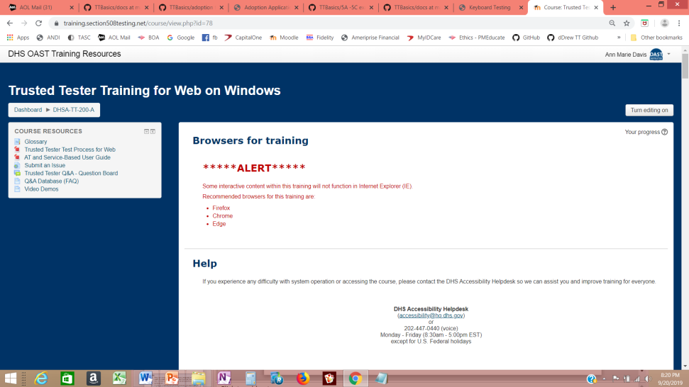
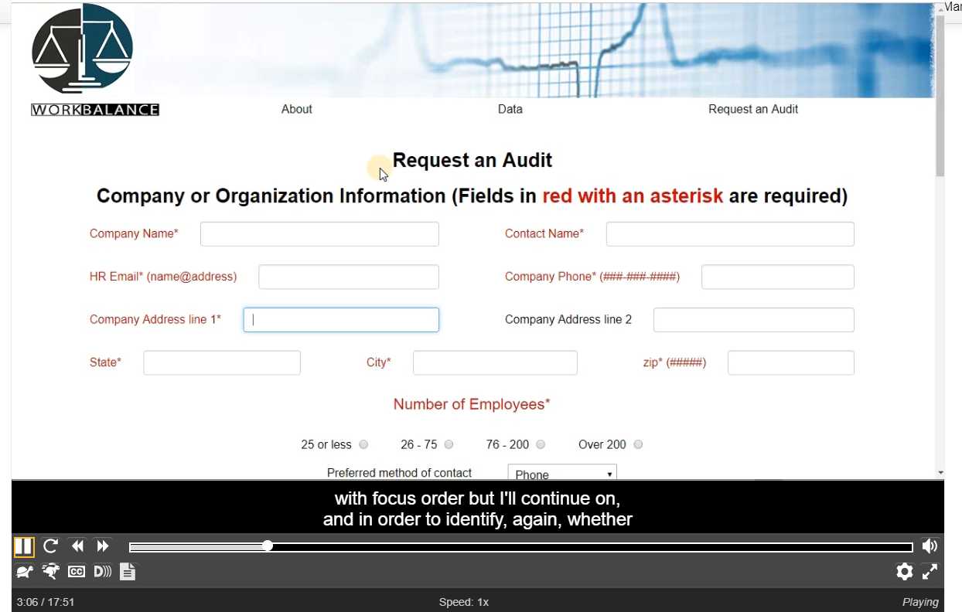
Course Video
Keyboard traps and other keyboard issues are difficult concepts for many students.
The course provides a video demonstrating the testing of the incremental exam page which can be found in the course resources page

Slide 19
4.D 2.4.7-focus-visible
Test Name | Test ID | Test Condition
2.4.7-focus-visible | 4.D | A visible indication of focus is provided when focus is on the interface component.
Evaluate Results:
If the following is TRUE, the content PASSES:
When each interface element receives focus, there is a visible indication of focus.
Tips
Look carefully as there is not a contrast requirement for focus in AA standard – that is AAA.
DO NOT use ANDI for this test since it can add markup that will skew your test results.
Emphasis is on the interactive element.
Does not apply to elements that do not receive keyboard focus. (Those elements are not failed for both 4.A and 4.D.)
Focus indicator is not required to be the same – can be outline, change in hue (though not use of color), making font bold.
Notes:
Need failing and passing examples of visible focus. Passing examples should use multiple methods, such as shading & outline

Slide 20
Notes for Focus with Frames
Note
To confirm keyboard focus is on a frame when there is not visible focus:
Use the TAB and SHIFT + TAB combination to deduce that the keyboard focus is on the frame.
When on the frame, a tab forward should move focus to the first keyboard focusable element within the frame.
From there, SHIFT + TAB once to move back to the frame and another SHIFT + TAB should move focus to a keyboard focusable element before the frame.
Only the frame is permitted to not have a visible focus. Be certain it is the frame that does not have a visible focus and not another element.
Notes:
Need example

Slide 21
4.E 3.2.1-on-focus
Test Name | Test ID | Test Condition
3.2.1-on-focus | 4.E | When an interface component receives focus, it does not initiate an unexpected change of context.
Evaluate Results:
If the following is TRUE, the content PASSES:
An unexpected change of context is not initiated when an interface component receives focus.
Definitions
Change of Content: The page content changes in a way that is expected related to expanding an outline, revealing/hiding content, or accessing a dynamic menu.
Change of Context: There is a major change in content that, if made without user awareness, can disorient users who are not able to view the entire page simultaneously. Examples of a change in context include:
Opening a new browser window.
Moving focus to a different component.
Submitting a form automatically when a component receives focus.
Going to a new web page or window, or appearing to do so.
Significantly rearranging the content of the page.
Notes:
Need passing and failing example

Slide 22
Tips for Focus Order
Tips
Focus on an element should not bring an unexpected change – user needs to select the interface component to initiate the change = a new window is launched, or focus is moved to another interface component.
It is key to understand the difference between a change of content and a change in context. Applying this concept also impacts testing for forms in Topic 5 of the test process.

Slide 23
4.F 2.4.3-focus-order-meaning
Test Name | Test ID | Test Condition
2.4.3-focus-order-meaning | 4.F | The focus order preserves the meaning and operability of the web page.
Evaluate Results:
If the following is TRUE, the content PASSES:
The focus order preserves the meaning of the page, AND
The focus order preserves the operability of the page.
Definition
A modal dialog box (such as a Save As dialog box) requires a user to interact with it before they can go back to the main page. Visual focus is expected to remain within a modal dialog box until it is closed.
Notes:
ANDI tab order markup may be slightly different in certain browsers than a keyboard user’s experience. Always use results from keyboard navigation.

Slide 24
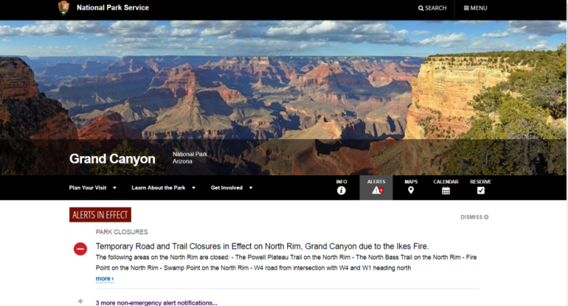
Tips on for Focus with Frames
Tips
Failures are most noticeable when focus order does not follow the logical order of operation (normally top to bottom, left to right).
The Focus order can be different if the specific order does not matter
https://www.nps.gov/grca/index.htm

Slide 25
4.G 2.4.3-focus-order-reveal
Test Name | Test ID | Test Condition
2.4.3-focus-order-reveal | 4.G | Focus is moved to revealed content.
Evaluate Results:
If any the following is TRUE, the content PASSES:
Keyboard focus moves directly to revealed content, OR
One additional keystroke moves the focus to revealed content
Notes:
One additional keystroke is allowed to achieve focus.

Slide 26
4.H 2.4.3-focus-order-return
Test Name | Test ID | Test Condition
2.4.3-focus-order-return | 4.H | Focus is returned to the logical sequence.
Evaluate Results:
If any the following is TRUE, the content PASSES:
Keyboard focus automatically returns to the logical sequence of focus order before the content was revealed, OR
One additional keystroke or keystroke combination returns focus to the logical sequence of focus order before the content was revealed
Tips:
It may be necessary to Press the SHIFT + TAB keys or an arrow key to move focus backwards.
One additional keystroke is allowed to achieve the expected return of focus.

Slide 27
Course Answer Tips
Mark every instance of a failure (no less, no more)
Follow instructions on the top of answer sheets to mark answers
4.A and 4.B and 4.E - Select the checkbox for every failing item
4.C - Select the FIRST and LAST checkboxes for elements defining a keyboard trap
4.D and 4.F - Select the checkbox for the LAST item receiving visible/expected focus
4.G - Select the checkbox for what INITIATED unexpected focus
4.H - Select the checkbox for what SHOULD HAVE received focus

Slide 28
Content Structure
Topic 10

Slide 29
10.A 2.4.6-heading-purpose
Test Name | Test ID | Test Condition
2.4.6-heading-purpose | 10.A | Each heading describes the topic or purpose of its content.
Evaluate Results:
If the following is TRUE, the content PASSES:
The heading describes the topic or purpose of its content.
Tip:
No tool is required – identify visually apparent headings and review the content beneath them.
Not required to have headings.
Heading tests divided to meet different WCAG success criteria

Slide 30
10.B 1.3.1-heading-determinable
Test Name | Test ID | Test Condition
1.3.1-heading-determinable | 10.B | Each programmatically determinable heading is a visual heading and each visual heading is programmatically determinable.
Evaluate Results:
If ALL of the following are TRUE, then the content PASSES:
Each programmatically determinable heading is serving as a visual heading on the page, AND
Each visual heading is programmatically defined.
Tip:
If it looks like a heading, it must programmatically be a heading. If is programmatically a heading, it must be functioning as a heading (cannot use a heading format for style).
Check if frames or iframes contain headings.

Slide 31
10.C 2.4.6-heading-level
Test Name | Test ID | Test Condition
1.3.1-heading-level | 10.C | Programmatic heading levels logically match the visual heading presentation within the heading structure.
Evaluate Results:
If ALL of the following are TRUE, then the content PASSES:
Every programmatically identified heading level logically matches the visual heading structure on the page, AND
There is no heading level conflict.
Tip:
More than one <h1> can be used on a page.
Heading levels may use different sequence
<h4> following <h2>, no <h3> in between) as long as it is consistent , matches the importance level, and communicates same thing visually on the page.
an <h2> heading may be used for a navigation structure that precedes an <h1> title on a page.

Slide 32
10.D 1.3.1-list-type
Test Name | Test ID | Test Condition
1.3.1-list-type | 10.D | All visually apparent lists are programmatically identified according to their type.
Evaluate Results:
If ALL of the following are TRUE, then the content PASSES:
All content that has the visual appearance of a list is defined programmatically as a list, according to the type of list.
An unordered list (with or without bullets) is marked as an unordered list (ul).
An ordered list is marked as an ordered list (ol).
Terms and their descriptions that are presented in the form of a list are marked as a description list (dl)
AND
All programmatic list relationships, including nesting and hierarchies, are consistent with the list relationships presented visually.
https://www.w3.org/TR/WCAG20-TECHS/H48.html

Slide 33
List Tips
Tips:
Not all lists require markup. For instance, a list of items in a sentence, separated by commas, do not have to be included in a bulleted or numbered list.
If something looks like a list, but does not have a list markup, use ANDI to check the reading order to determine if it makes sense.
Check if content is in a frame or iframe.

